Slide 1
Analysis of Few Shot Object Detection with Fine-tuning
Chetan Reddy Jean-Bernard Uwineza Sayak Nag
Om Shankar Ohdar Vikarn Bhakri
EE260: Intro to Deep Learning

Slide 2

What is Image Classification?
Object Classification involves recognizing specific pre-specified objects or object classes.
Images are classified into different classes based on object they contain.
It could be binary, or multi-class.
Notes:
3. In most instances, image classification involves many classes.
4. For binary classification, it answers the question: does this image contain cats?
For multi-class, it answers the question: does this image contain cats, or dogs, and many other pre-specified objects?

Slide 3
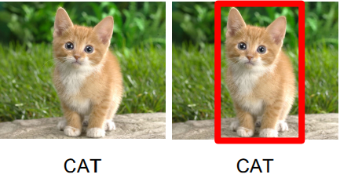
What is Object Localization?
Object Localization aims to locate the main (or most visible) object in an image.
Different from image classification as it require both classification of an object and its localization.
A Bounding box is usually put around the recognized object.
Notes:
3. This answers 2 questions at once. Is there a cat in this picture? If so, where is it?
End. But if we want to locate other possible objects as well?

Slide 4
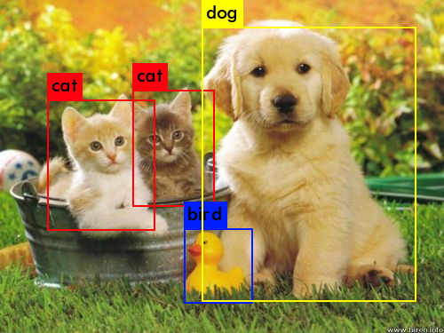
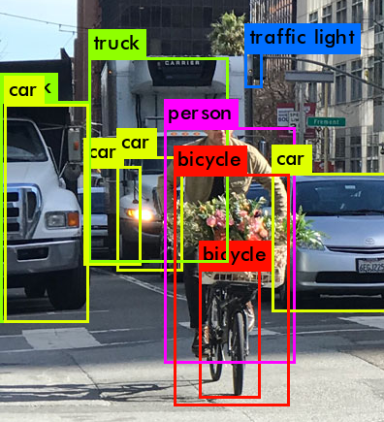
Object Detection
Object Detection combines classification and localization for all objects.
Each recognized object is given a location (bounding box) and a class label.
Notes:
2. This is, in a way, object localization for all possible pre-specified object classes. It could be thought as the multi-class version of object localization.

Slide 5
Few Shot Detection
Training a detector requires many training examples per class.
To introduce new classes, there should be many examples to re-train or fine-tune the model.
Few Shot Detection is an active area that attempts to use as few training examples for novel classes of objects.
There are two prominent approaches:
Meta-learning & Few-shot finetuning
Notes:
2. What if we want to introduce new classes?
3. We do not want to retrain the model using many examples for each new class introduced.
4. One method is based on finding new feature weights for novel classes, the other on finetuning trained models.

Slide 6
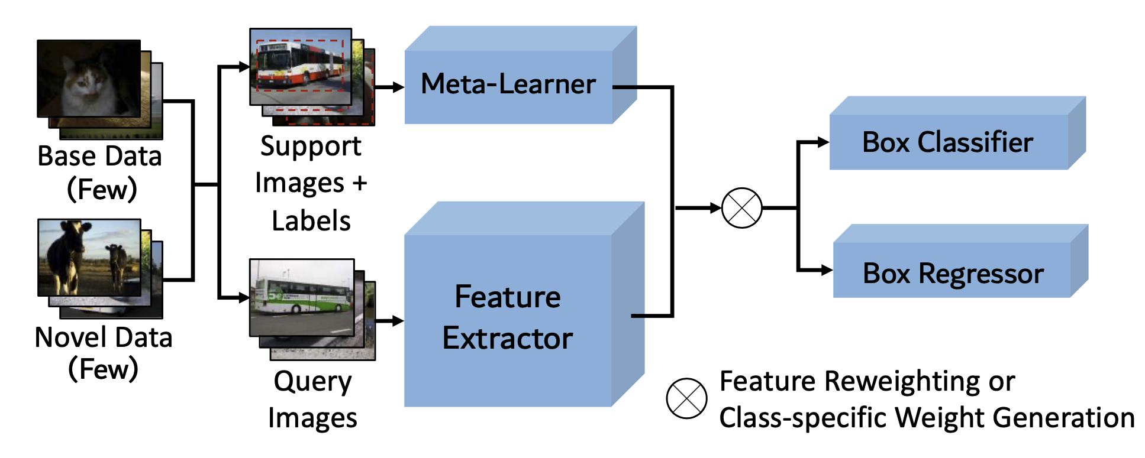
Meta-Learning
A meta-learner obtains class-level meta features.
The model generalizes to novel classes through feature re-weighting (Kang et al. 2019) or class specific weight generation (Yan et. al. 2019).
Generally, training is done in two stages.

Slide 7
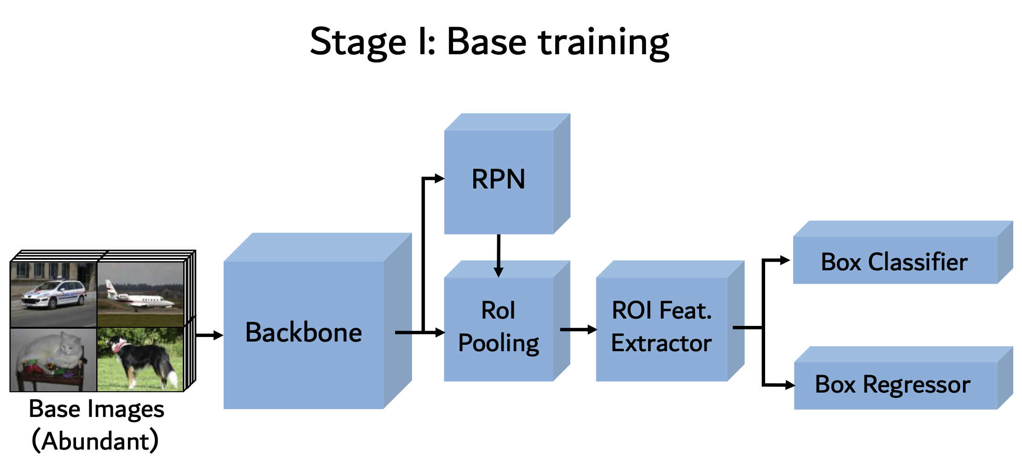
Few-shot Finetuning
Backbone: ResNet
ROI Feat. Extractor: Faster-RCNN (Ren et al., 2015)

Slide 8
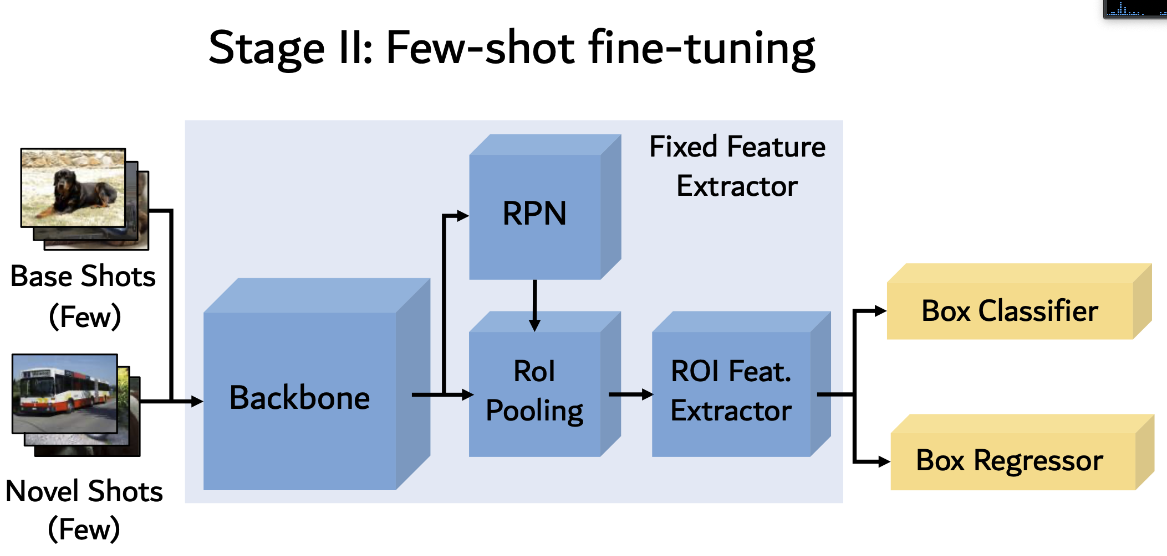
Few-shot Finetuning
Proposed by Wang et. al. 2020, the entire network is not tuned to novel category samples but only the last layers of the detector.

Slide 9
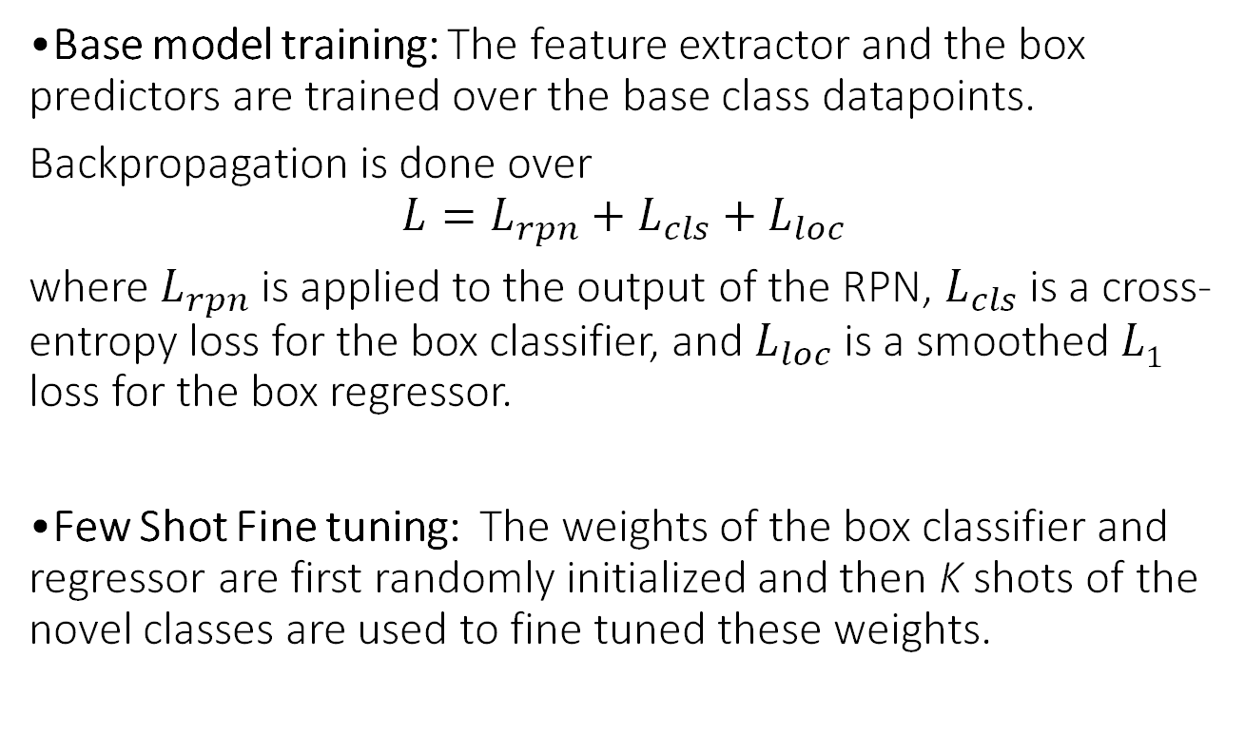
Training: Process
•Base model training: The feature extractor and the box predictors are trained over the base class datapoints.
Backpropagation is done over
$$L=L_{rpn}+L_{cls}+L_{loc}$$
where $L_{rpn}$is applied to the output of the RPN, $L_{cls}$is a cross-entropy loss for the box classifier, and $L_{loc}$is a smoothed $L1$ loss for the box regressor.
•Few Shot Fine tuning: The weights of the box classifier and regressor are first randomly initialized and then K shots of the novel classes are used to fine tuned these weights.

Slide 10
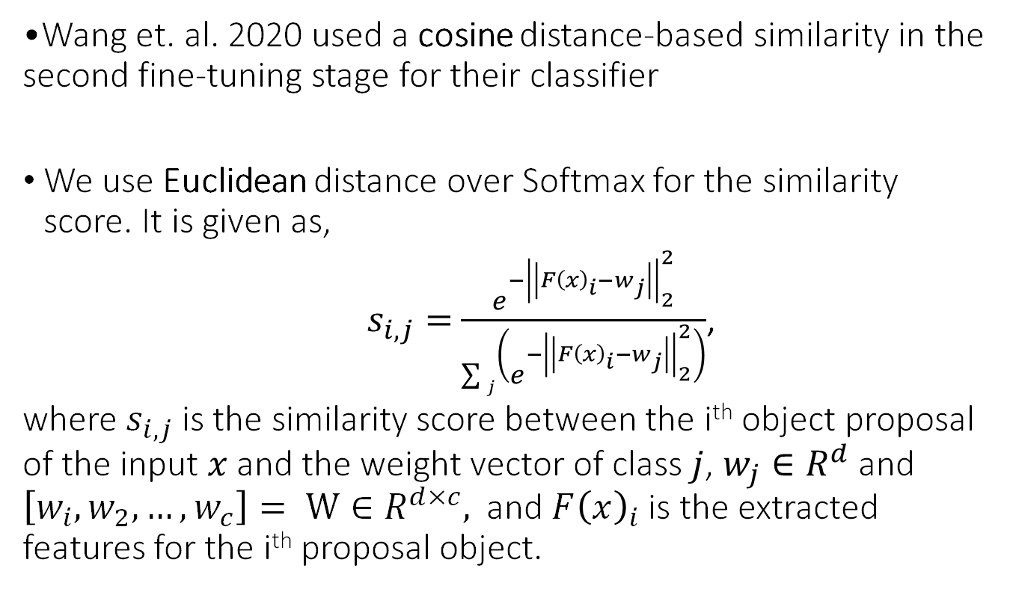
Training : Euclidean Distance based Similarity
•Wang et. al. 2020 used a cosine distance-based similarity in the second fine-tuning stage for their classifier
We use Euclidean distance over Softmax for the similarity score. It is given as,
$s_{i,j}=$ $\frac{e^{−{\left|\left|F{\left(x\right)}_{i}−w_{j}\right|\right|}_{2}^{2}}}{\sum{j\left(e^{−{\left|\left|F{\left(x\right)}_{i}−w_{j}\right|\right|}_{2}^{2}}\right)}}$,
where $s_{i,j}$is the similarity score between the i^{th} object proposal of the input $x$ and the weight vector of class $j$, $w_{j}∈R^{d}$ and $\left[w_{i},w_{2},…,w_{c}\right]= W∈R^{d×c},$ and $F{\left(x\right)}_{i}$ is the extracted features for the i^{th} proposal object.

Slide 11
Data
Model was evaluated on the COCO, PASCAL-VOC and KITTI dataset.
The COCO dataset (2014) is a common object dataset with 80 classes. It has 80000 training images.
The PASCAL-VOC dataset (2007) is a visual object dataset with 20 classes. It has 9963 total images. 5000 were used for training.
The KITTI dataset is a real-world dataset of traffic images such as pedestrians, cars and buses. We take 50 images and separate them into two classes of pedestrian and cars for our few shot experiments.

Slide 12
Experimental Setup
The model was trained using SGD with momentum=0.9 along with weight decay of 0.0001, and a batch size of 16.
We used a learning rate of 0.02 for base training and 0.001 for novel class training.
For base training, the model was trained for 20 epochs in total with early stopping for COCO and Pascal-VOC and then fined-tuned for the novel categories for 10 epochs.
For KITTI the PASCAL-VOC base feature detector was fixed and only the last layers we fine-tuned for 20 epochs.

Slide 13
Results
mAP50(threshold=0.5) results on test points
C.S.: Cosine Similarity
 | 1-Shot (Ours) | 1-Shot(C.S.) | 5-Shot (Ours) | 5-Shot(C.S.) | 10-Shot (Ours) | 10-Shot(C.S.)
COCO | 36.3 | 39.8 | 43.1 | 41.2 | 48.1 | 42.2
PASCAL-VOC | 37.1 | 39.8 | 56.3 | 55.7 | 49.6 | 56
KITTI | 22.5 | N/A | 31.7 | N/A | 29.8 | N/A

Slide 14
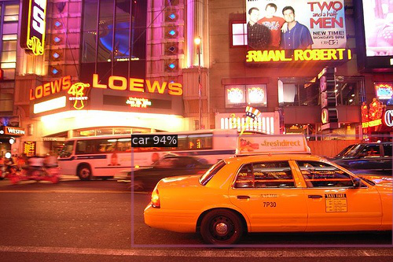
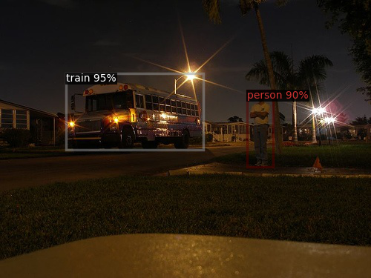
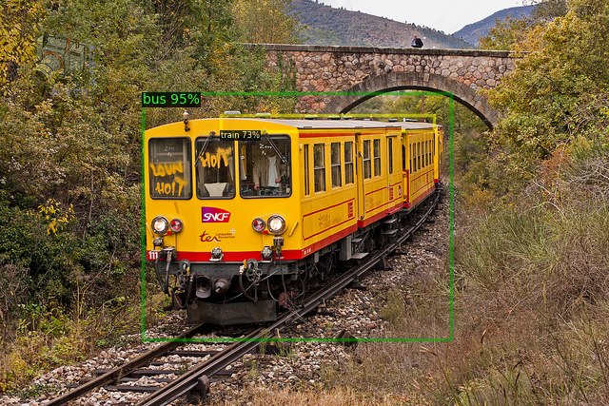
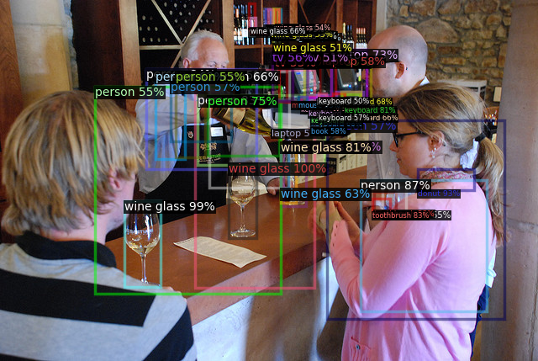
Results : COCO- 1 Shot

Slide 15
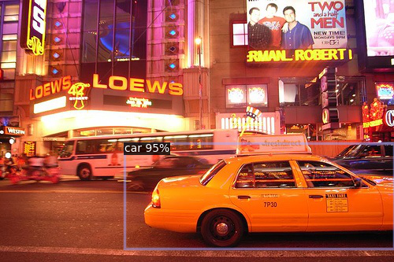
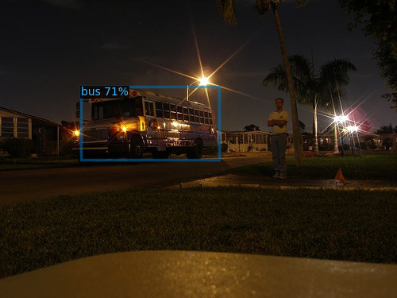
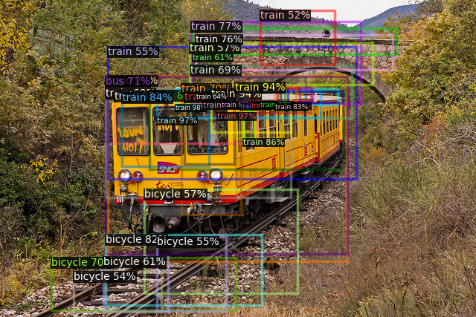
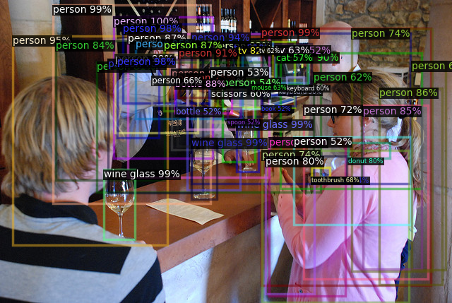
Results : COCO- 5 Shot

Slide 16

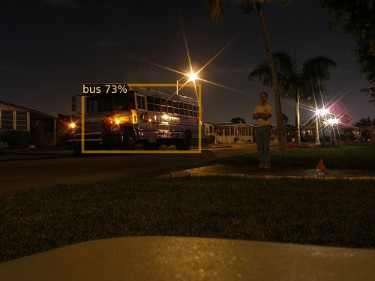
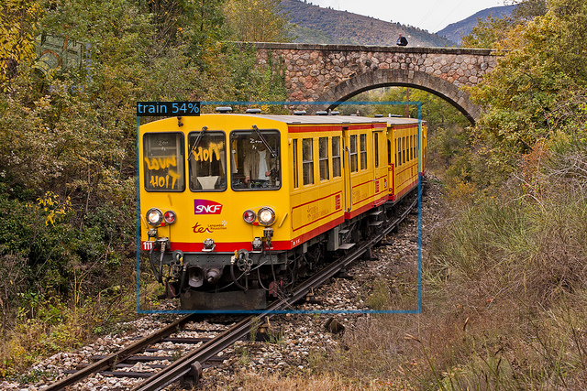
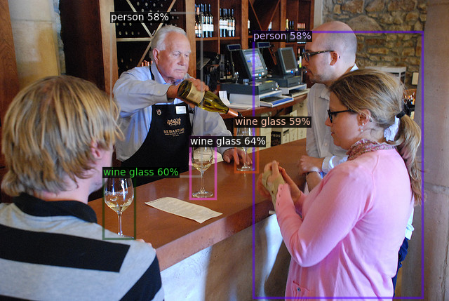
Results : COCO- 10 Shot

Slide 17
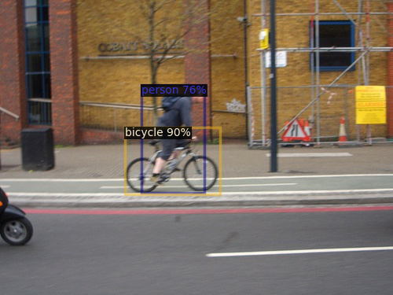
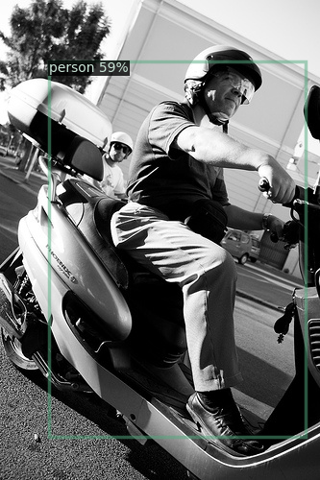
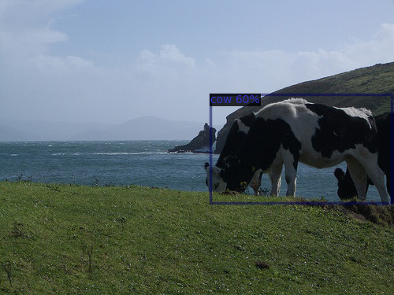
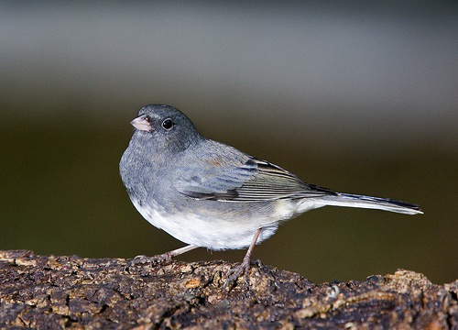
Results: PASCAL- 1 Shot

Slide 18
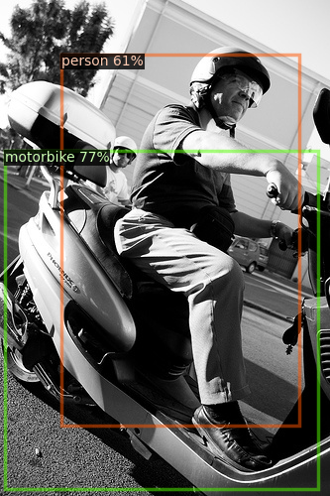
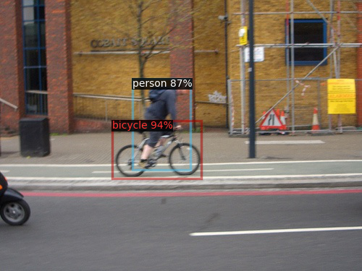
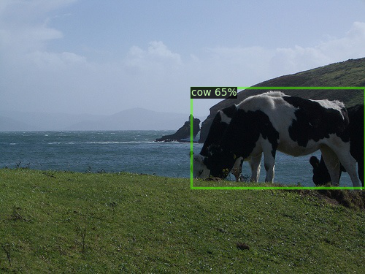
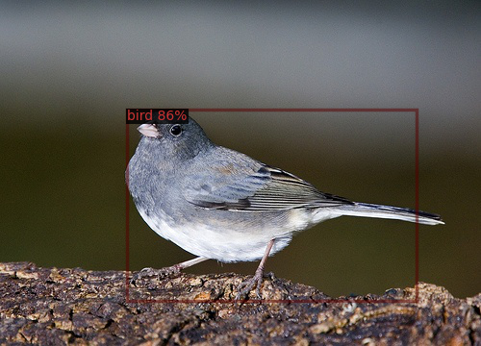
Results: PASCAL- 5 Shot

Slide 19
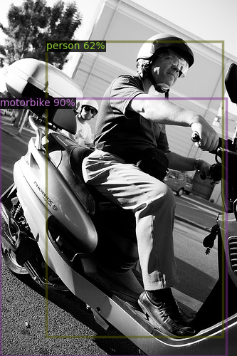
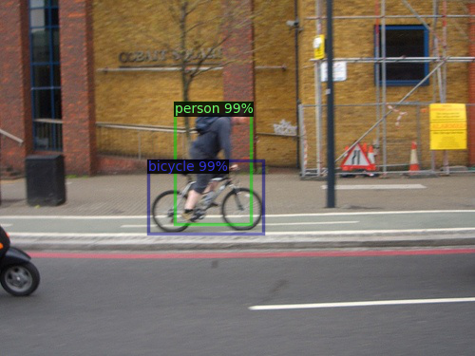
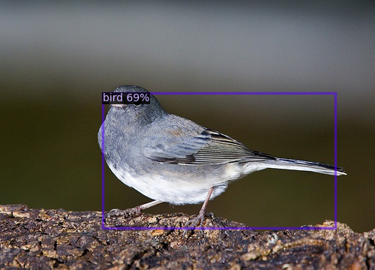
Results: PASCAL- 10 Shot

Slide 20
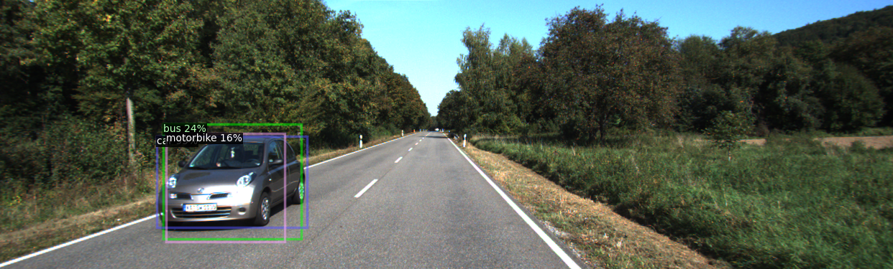
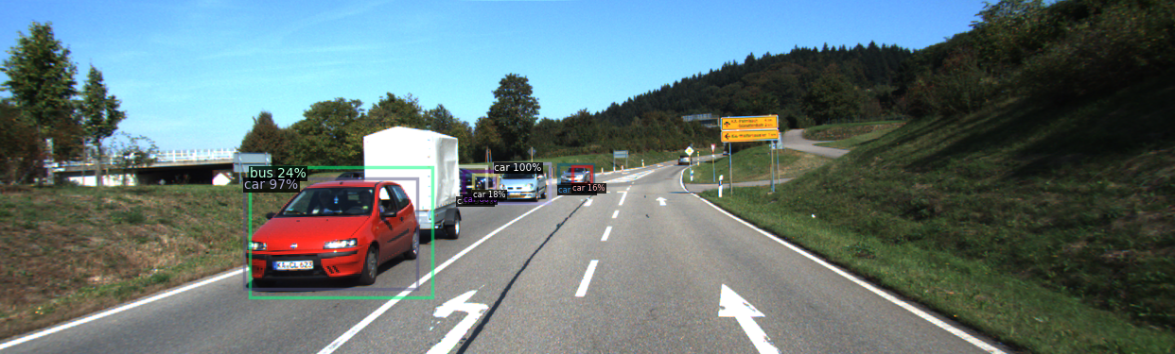
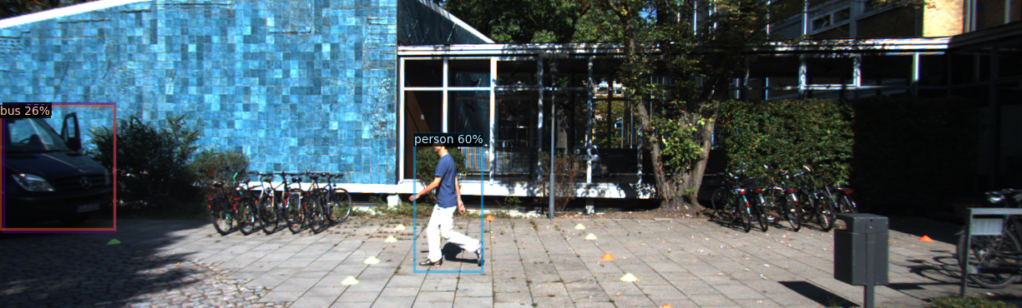
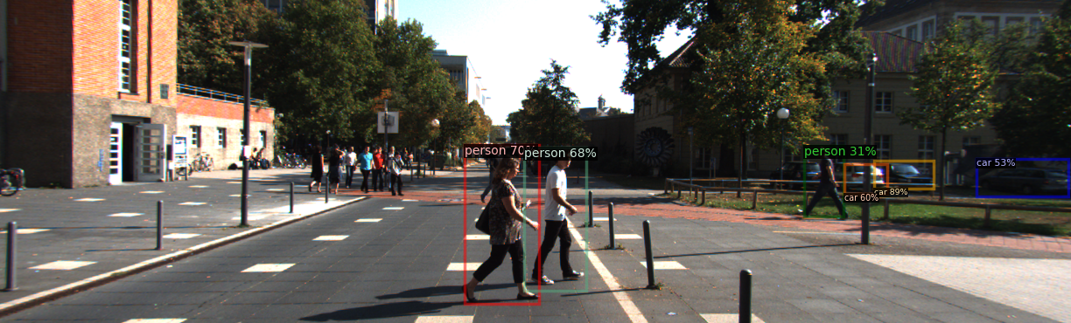
Results: KITTI –1 Shot

Slide 21
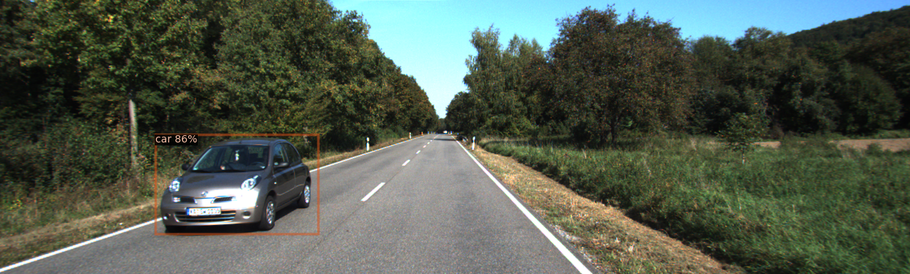
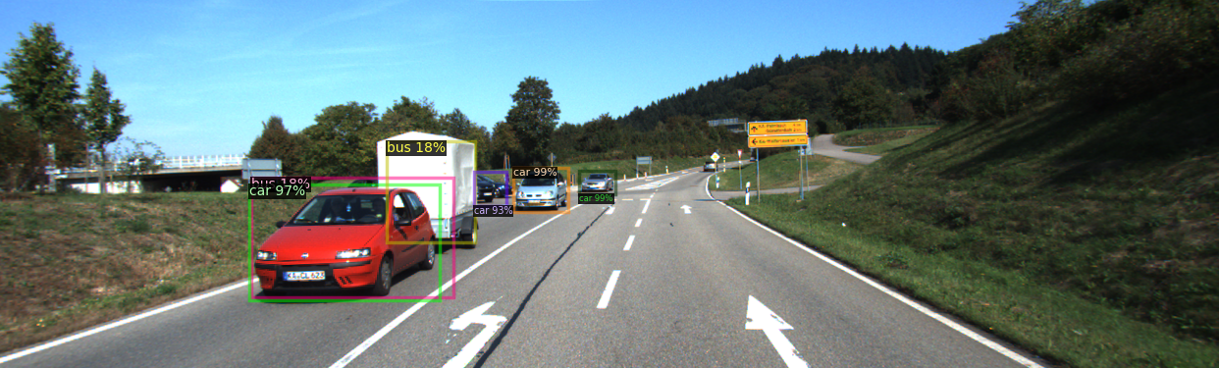
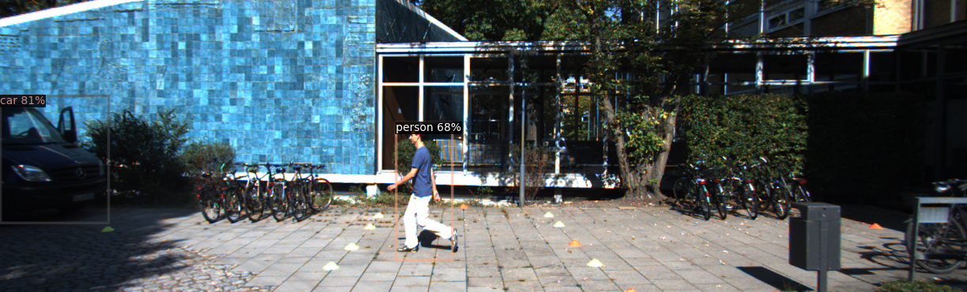
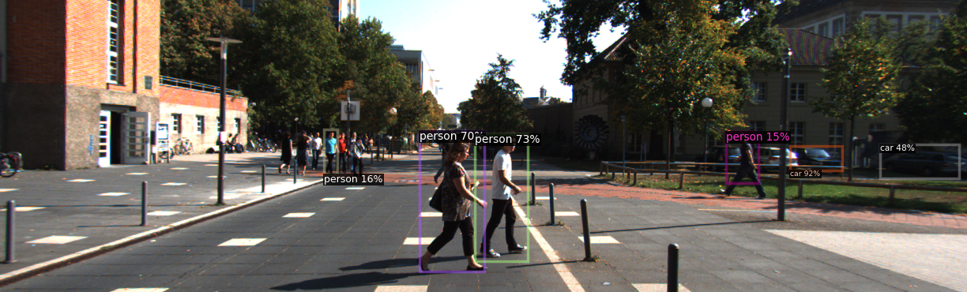
Results: KITTI –5 Shot

Slide 22

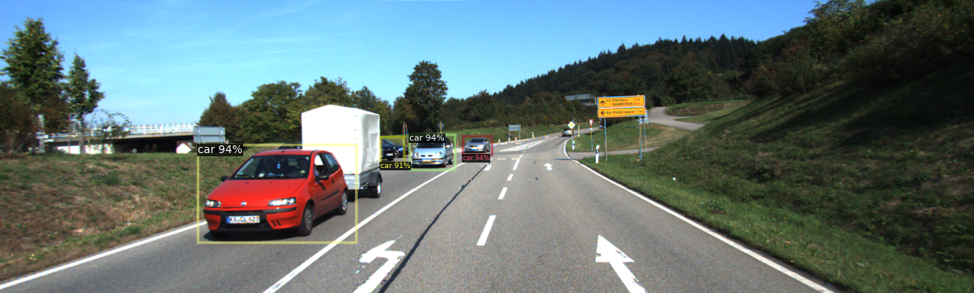
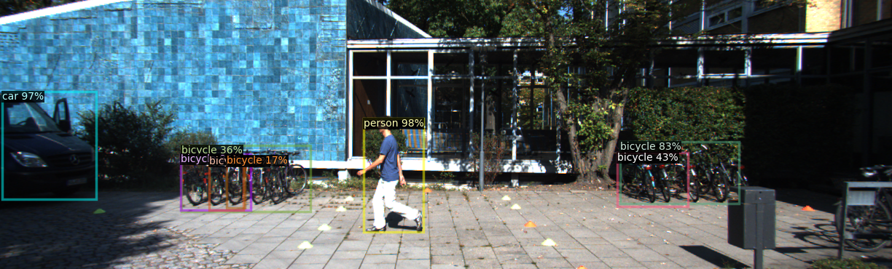
Results: KITTI –10 Shot

Slide 23
Conclusion
We use Euclidean distance based Softmax similarity score in our few-shot experiments and showed that it gives comparable results to cosine similarity.
We also show how few shot detection can be used to detect objects in traffic images by evaluating on the KITTI dataset.
One shot is usually not enough, but 10 shots are plenty.
Further, the capability of these models for 3D object detection can also be explored.

Slide 24
Thank you!
Questions?
(Not you, Miraj & Abhishek.)

